Slide 1

Project Management Masterclass Day One

Slide 2

Hi team! It's me,
Anmol Adhikari
Excited to come on board!

Slide 3


Past Work Experiences
A quick run down of the companies I've worked with
2018
2019
2023
Project Manager
CTO
Module Leader \ Lecturer
Bluebell Software Solution
Surya Print & Pack Pvt. Ltd.
Herald College Kathmandu

Slide 4
Expectation
What we will be learning?
How will we learn?
Google Meet for classes
Discord for communication
Email for official announcement

Slide 5
Rules
Things we should follow
Video
Please turn on your video for more engagement.
Submission
You need to submit your review for the teacher, and course and submit your notes everyday.
NDA
By attending this event, you follow our Non-Disclosure Agreement to not expose any data outside of this
environment, including images, videos, codes and all other assets.

Slide 6

Grading Pattern
Attendance
Attendance is mandatory and will be marked by 1 points daily
Coursework Submission
At the end of the masterclass you need to submit your work and will be marked out of 10.
Daily Review
Instructor review and course review needs to be submitted at the end of
everyday and will be marked 2 marks.
Note Submission
You need to submit your notes for the day everyday and will be awarded 1 marks
Peer-to-peer grading
You need to review the coursework of another student to get awarded marks. 2 points per coursework will be awarded

Slide 7

Clear your mind
PM principles, tools and techniques are
very much based on common sense.
Consider most of the things as guidelines and practical lessons for you – there is no formula on how best to prepare a project plan.
This does not mean it is easy, and you do not need good preparation to handle a project yourself.
Try not to think in absolute terms – rarely, there are black and white options. There are often many shades of grey in between.

Slide 8
Definition of a Project
What is a Project?
“A project is a temporary endeavor undertaken to create a unique product, service or result.”
- Project Management Body of Knowledge PMBOK Guide 5th Ed

Slide 9



Characteristics of a Project
Has a
beginning and an end
Projects are temporary initiatives. This is the main difference
Delivers a
unique output
Each project is “unique” in the sense that it creates something never done before. Even if the output of the project is very similar to the one of a previous project, the fact that it will be at a
Includes
complex activities
Projects include complex
activities, which need time for
between projects and the day-to- day normal business operations
coordination. The complexity comes mainly from the fact that projects have constraints (limited time and resources) and need to deal with uncertainty (tasks to be done in the future).
(e.g. production,
sales, HR, logistics, IT,
supply-chain and
finance and accounting, etc.).
different time with different
people makes it distinct.

Slide 10
The Triple Constraint in Project Management
There are three fundamental factors for each project:
Scope = the sum of the activities and work to be performed in order to reach the project goal. In other words, the scope is
Scope
everything that needs to be done during the project.
Time = the available timeframe given for the project to reach its goal.
Cost = the resources available for the project.
The three dimensions always need to be looked at together because:
If a change is made to one of them, one or both the others will change as well
Example: you are planning to build a two-floor house (scope) until the end of the summer (time) and within a specific budget (cost). If things change and you decide you need three floors to be constructed (scope change), you will need more resources (cost) and most probably more time.
Another example would be if you decide you need the house ready before the summer (time change). This would mean you need extra workers to complete the construction faster (cost) and/or you might need to simplify the construction - e.g. skip the interior works (scope).
Time
Cost

Slide 11

Who is the Project Manager?
Project management costs generally a total between 7-15% of the project’s Total Installed Cost.
You can think of the PM as the “CEO” of the project.
The accountable person for the project’s success*.
*Project success = accomplish the specific goal of the project,
within the time and budget constraints upon from the beginning.
Why do you need a PM?
To take accountability
To steer people and activities
To handle risks and issues

Slide 12
Project Manager Skills
In projects, there are different individuals and organizations that need to work in a coordinated manner for the success of the project. As mentioned, the PM is the “face” of the project. He/she is the single point of contact who can answer any question about his/her project, including all works streams and tasks performed by other people. PM is accountable for the end result of their collective work.
It might sound easier than it is. So, how to do it? We explained, that PMs have the knowledge, skills, attitude and practical experience to “manage” not only their work, but also the work of the others. In addition, by being appointed as a PM, you are being empowered by the Project Sponsor to take action and make decisions. These skills, knowledge, and attitude are not limited to:
Project management and business knowledge: Ability to lead project work, and know-how to address classical project situations; knowledge of the project lifecycle; planning quality; management of project’s critical areas; work with project management tools and documents. Put controls in place to be able to track progress. Business analysis skills; business acumen; awareness and knowledge of the PM industry standards.
People and Workflow Management Skills: Efficiently organize project work, and define responsibility and due date. Issue resolution skills; people skills
- work with all stakeholders, motivate project team, communicate in a way to create trust among the team members and senior management.
Strategy and Leadership Skills: Negotiate, and influence work and stakeholders in the project/program interest; work towards the objectives of the overall program; ensure work is aligned with the overall corporate strategy. Promote the values and benefits of the project/program to the broad organization.
These are all central to the PM role. To this, however, we want to highlight a few other characteristics: The attitude, behavior, and professionalism that the PM expresses are very important for the image of the project - the organization’s perception of the work:
Attitude and behavior: Positive and goal-oriented attitude, especially during difficult times. Projects are complex initiatives that include various subjects, people and personalities, expectations, and constraints. There can often be competition for resources and tension due to constraints. PM has to be able to handle the pressure and stress that can emerge. In the meantime, take the right decisions and trade-offs. A good PM works well under pressure to keep the project on the path to success.
Professionalism: Irrespective of the challenges, a PM is a business professional. As such, they need to act as an example, and show high morale, ethics, and credibility.

Slide 13
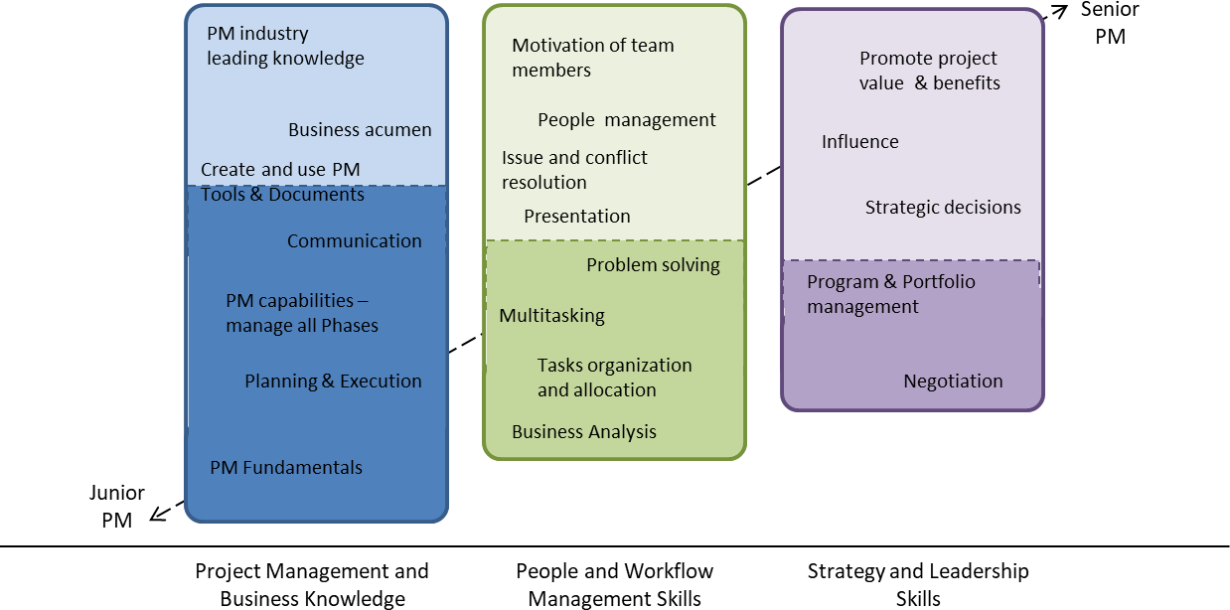
The development of the skills

Slide 14



Definitions and Terminology
Project Sponsor
The individual accountable for the overall project success and for obtaining the expected business benefits of the project, usually a senior or executive manager. Key responsibilities: approve the project, provide the needed resources, support the activities, and resolve issues.
Project Team
The team members are the experts responsible for the actual execution of the work (e.g.
developers on a software project).
Project Stakeholders
All individuals or organizations that can be interested in the project’s work and result and influence it – participants, management, competitors, vendors, clients, and in some cases, the society (e.g. public infrastructure projects).

Slide 15
Project Phases
As we defined at the beginning of the course, each project is unique. The specificity of the desired result, the involvement of different people and personalities, different time and circumstances all contribute to separating each project from the rest.
Nevertheless, the PM’s discipline has established a common view on how each project evolves from the start to the end. The world’s leading project management
professional organization – “Project Management Institute” or “PMI” – has determined projects have five phases (or process groups):
1. Initiation – This is a preliminary phase during which the project foundations are laid by the Project Sponsor. The overall objective, concept, or problem to be resolved is defined. Overall timeline (expected date for completion) and budget are suggested. These are all documented in the project’s Business Case. A Project Manager is identified and assigned to start working on the project.
Planning – Essential part of any project, which often makes the difference. Good planning increases the chances of completing a project within time and budget. During this phase, the PM has to do substantial preparation – to correctly define the work to be done, to organize the way the work will be executed, and to estimate and define timelines, the necessary budget, resources, management attention, etc. PM has to ask the right questions and then work with other project stakeholders to find the needed information. What do we need to do to meet the objective? How will we do everything? Who will do what work? When should the tasks finish, in order not to slow down the next ones? How will we make sure issues are quickly identified? What are the risks that can hurt the project? How to make sure we don’t spend more dollars than needed? Which people are expected to cause problems? How do we keep the project safe from them? And there are many other questions. The way the PM will answer those questions is key. It can maximize the chances of meeting the project goal, but, if not performed well, it can expose the work to many additional risks and create an environment of insecurity. Planning = also your strategy on how to win.
Execution – This is the phase during which the actual project work is performed, the deliverables are created. In construction projects, this would include constructing the building or infrastructure. In process improvement projects, these would be all actions aimed at identifying the opportunities and implementing the changes in the organization. In software development, this would represent coding and programming, etc. The key role of the PM will be to keep the project environment good, motivate the team, and help to resolve any issues that come up along the way.
Monitoring & Control – This phase goes hand in hand with Execution. The project manager uses the control systems developed to track if all project workstreams are progressing with the speed and quality to be completed within the timeline and budget. If there are any slowdowns, delays, gaps, these will be identified and the
manager will have to take action to “fix” them.
Closure – After all work is done and all deliverables are finalized, PM still has some work to do to formally complete the project. This would include doing a formal handover of the project product to the department or people it was designed for. Formal approval and sign-off have to be given by the Project Sponsor, confirming the mission describer in the initiation phase has been achieved. Last but not the least, the PM has to gather the team and stakeholders into a meeting to discuss the Lessons Learned – what went well, what did not go that well, and what can be done better during the next similar project. Continuous improvement is also very important in projects, as PMs constantly learn new things and build on their expertise. Formally documenting the feedback for the project is a key driver of this
process.
Execution
Initiation Planning
Closure
Monitoring & Control

Slide 16




Project Selection
PROJECT SUGGESTIONS
PROJECT VALIDATION
Can it deliver expected benefits?
Do we have the resources?
Can it be executed?
PROJECT SELECTION
VALIDATED PROJECT

Slide 17
Project Charter
The project charter is “a document issued by the project sponsor that formally authorizes the existence of a project, and provides the project manager with the authority to apply organizational resources to project activities.”
- Project Management Body of Knowledge PMBOK Guide 5th Ed

Slide 18



Characteristics of a Project Charter
Provides a big-picture view of the project
Gives the PM authority to use
organization’s resources
Defines objectives and success criteria for the project
A project charter is a broad statement of the:
Scope
Major milestones
Stakeholders
High-level assumptions
High-level risks
Project constraints These components are
specified in detail during the planning phase.
A project charter serves as a
contract between the project
The project objective is clearly
stated following
the SMART
sponsor manager. authority
and the project It defines the of
protocol.
This defines the success criteria
the project
that should be met project to be
for the
manager to spend money and to commit resources.
completed
successfully. The project who should
charter specifies
endorse the
completion of the project.

Slide 19
Conclusion
In conclusion, we learned that successful software development requires efficient project management, careful planning, and continuous monitoring throughout the development life cycle. With the right project management techniques, software development teams can achieve their objectives while meeting the project's requirements, budget, and timeline.

Slide 20


Turn challenges into opportunities.
Ask more.
QA Session

Slide 21
Anmol, Offline
See you tomorrow.

Slide 22
https://bit.ly/leaf-nepal-dm01-sub
REVIEW AND NOTE SUBMISSION

